Slide 1


SMART INDIA HACKATHON 2024
TITLE PAGE
Problem Statement ID – 1657
Problem Statement Title- Integrated Geo-Referenced Fish Catch Data Repository and Access System
Theme- Smart Automation
PS Category- Software
Team ID- 5055
Team Name – TECH SAMURAIS

Slide 2
IDEA TITLE
TECH SAMURAIS
We are building a system to collect, organize, and visualize geo-referenced fish catch data from multiple sources. This system will help scientific personnel easily access, filter, and analyze data to develop species-specific fishery forecasts, which will save time and effort in data collection and research.
Data Collection & Aggregation
We will automate data collection from various sources like research institutions and a dedicated app. This data will be aggregated into a central system in Excel/CSV formats.
Comprehensive Database
A structured database (PostgreSQL with PostGIS) will store fish catch data, categorized by species, location, date, depth, and abundance, ensuring easy access and analysis.
Data Filtering & Search Functionality
Users will be able to filter data by species, location, time, and depth through an intuitive interface, using advanced spatial and SQL queries for precise results.
Visualization & Mapping Tools
We will integrate mapping and charting tools like Leaflet.js and D3.js, enabling users to visualize species occurrence and abundance on maps and generate trend graphs.
User Access & Admin Control
A role-based access system will allow users to search and download data, while admins will have control over uploading, updating, and maintaining the database via a secure dashboard.

Slide 3
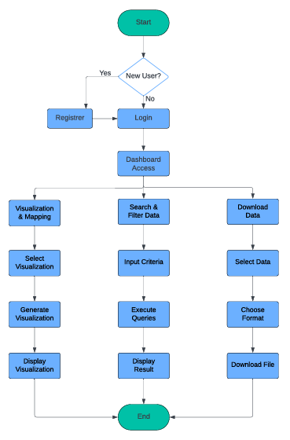
TECHNICAL APPROACH
TECH SAMURAIS
FLOW CHART
USE CASES
Data Access & Exploration
Users log in to access the system, search and filter geo-referenced fish catch data, and view detailed results. Enables users to easily find and analyze relevant data for research.
Data Visualization
Users generate interactive maps and charts to visualize fish catch data, helping to identify trends and patterns. Provides intuitive and insightful representations of data for better understanding and analysis.
Data Management
Admins upload, update, and validate data to ensure the repository remains accurate and up-to-date. Maintains data integrity and supports ongoing data quality.
User & Access Management
Admins manage user accounts and permissions, controlling access levels and ensuring secure interaction with the system. Protects sensitive data and regulates user access to various functionalities.

Slide 4
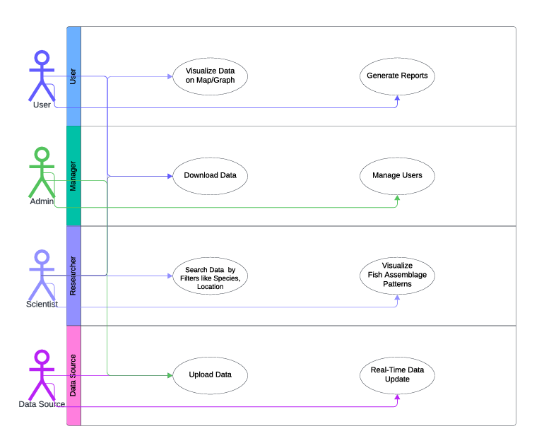







TECHNICAL APPROACH
TECH SAMURAIS
USE CASE DIAGRAM
Tech Stack
Front-end :
Back-end :
Database :

Slide 5
FEASIBILITY AND VIABILITY
TECH SAMURAIS
Feasibility Analysis
Potential Challenges and Risks
Strategies for Overcoming Challenges
Technical Feasibility:
Data Integration
Database Management
User Interface
Operational Feasibility:
User Requirements
Scalability
Economic Feasibility:
Cost Management
Long-Term Saving
Improved Resource
Allocation
Data Quality & Consistency:
Robust ETL Processes
Standardized Data Formats
Regular Audits
Data Security and Privacy:
Encryption
Role-Based Access Control
Security Audits
System Performance:
Optimize Queries
Scalable Infrastructure
Performance Monitoring
Data Quality & Consistency:
Accuracy Issues
Validation Complexity
Impact on Research
Data Security and Privacy:
Data Breaches
Access Control
Compliance
System Performance:
Handling Large Datasets
Query Complexity
User Experience

Slide 6



IMPACT AND BENEFITS
TECH SAMURAIS
IMPACTS
Scientific Community :
Enhanced Research Efficiency
Improved Forecasting
Data-Driven Insights
Fisheries Management :
Informed Decision-Making
Policy Development
Regulatory Compliance
Local Communities :
Economic Opportunities
Community Engagement
Environmental Organizations:
Conservation Efforts
Advocacy
Benefits
Social: Informed Public, Educational Resource, Enhanced Collaboration
Economic: Cost Savings, Sustainable Fisheries and Increased Efficiency
Technical : Advanced Analytics and Improved Data Accessibility
Environmental: Sustainable Practices and Ecosystem Monitoring
REFERENCES
Murray, T., & Parry, M. (2020). "Data-Driven Approaches to Fisheries Management: Integrating Data and Knowledge." Fish and Fisheries. Retrieved from Wiley Online Library
Graham, C. H., & Hijmans, R. J. (2022). "Novel Methods Improve Prediction of Species' Distributions from Occurrence Data." In Ecography. Retrieved from Wiley Online Library​

